Slide 1
GOF Design Patterns-1

Slide 2
Structural Pattern:Adapter
Intent
  Convert the interface of a class into another interface clients expect. Adapter lets classes work together that couldn't otherwise because of incompatible interfaces.
Also Known As
  Wrapper

Slide 3
Adapter
Motivation
  Sometimes a class that's designed for reuse isn't reusable only because its interface doesn't match the domain-specific interface an application requires.
    Example
      Design Editor

Slide 4
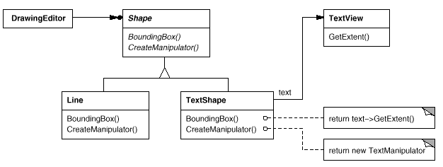
Adapter

Slide 5
Adapter
This diagram illustrates the object adapter case. It shows how BoundingBox requests, declared in class Shape, are converted to GetExtent requests defined in TextView. Since TextShape adapts TextView to the Shape interface, the drawing editor can reuse the otherwise incompatible TextView class.

Slide 6
Adapter
Applicability
  Use the Adapter pattern when
  you want to use an existing class, and its interface does not match the one you need.
  you want to create a reusable class that cooperates with unrelated or unforeseen classes, that is, classes that don't necessarily have compatible interfaces.
  (object adapter only) you need to use several existing subclasses, but it's impractical to adapt their interface by subclassing every one. An object adapter can adapt the interface of its parent class.

Slide 7
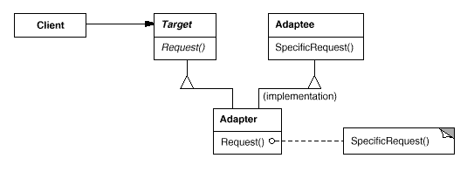
Adapter
Structure
  A class adapter uses multiple inheritance to adapt one interface to another:

Slide 8
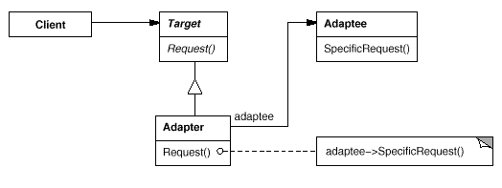
Adapter
An object adapter relies on object composition

Slide 9
Adapter
Participants
  Target (Shape)
    defines the domain-specific interface that Client uses.
  Client (DrawingEditor)
    collaborates with objects conforming to the Target interface.
  Adaptee (TextView)
    defines an existing interface that needs adapting.
  Adapter (TextShape)
    adapts the interface of Adaptee to the Target interface.

Slide 10
Adapter
Collaborations
  Clients call operations on an Adapter instance. In turn, the adapter calls Adaptee operations that carry out the request.

Slide 11
Consequences
Class and object adapters have different trade-offs. A class adapter
  adapts Adaptee to Target by committing to a concrete Adaptee class. As a consequence, a class adapter won't work when we want to adapt a class and all its subclasses.
  lets Adapter override some of Adaptee's behavior, since Adapter is a subclass of Adaptee.
  introduces only one object, and no additional pointer indirection is needed to get to the adaptee.
An object adapter
  lets a single Adapter work with many Adaptees—that is, the Adaptee itself and all of its subclasses (if any). The Adapter can also add functionality to all Adaptees at once.
  makes it harder to override Adaptee behavior. It will require subclassing Adaptee and making Adapter refer to the subclass rather than the Adaptee itself.

Slide 12
Adapter
Related Patterns
  Proxy
  Decorator
  Bridge

Slide 13
Creational Pattern:Factory Method
Intent
  Define an interface for creating an object, but let subclasses decide which class to instantiate. Factory Method lets a class defer instantiation to subclasses.
Also Known As
  Virtual Constructor

Slide 14
Factory Method
Motivation
  Frameworks use abstract classes to define and maintain relationships between objects. A framework is often responsible for creating these objects as well.
  Consider a framework for applications that can present multiple documents to the user.
  Two key abstractions in this framework are the classes Application and Document. Both classes are abstract, and clients have to subclass them to realize their application-specific implementations.
  To create a drawing application, for example, we define the classes DrawingApplication and DrawingDocument. The Application class is responsible for managing Documents and will create them as required—when the user selects Open or New from a menu, for example.

Slide 15
Factory Method
Because the particular Document subclass to instantiate is application-specific, the Application class can't predict the subclass of Document to instantiate—the Application class only knows when a new document should be created, not what kind of Document to create.
The framework must instantiate classes, but it only knows about abstract classes, which it cannot instantiate.
The Factory Method pattern offers a solution. It encapsulates the knowledge of which Document subclass to create and moves this knowledge out of the framework.

Slide 16
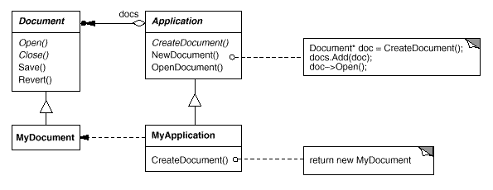
Factory Method

Slide 17
Factory Method
Application subclasses redefine an abstract CreateDocument operation on Application to return the appropriate Document subclass.
Once an Application subclass is instantiated, it can then instantiate application-specific Documents without knowing their class.
We call CreateDocument a factory method because it's responsible for "manufacturing" an object.

Slide 18
Factory Method
Applicability
  Use the Factory Method pattern when
  a class can't anticipate the class of objects it must create.
  a class wants its subclasses to specify the objects it creates.
  classes delegate responsibility to one of several helper subclasses, and you want to localize the knowledge of which helper subclass is the delegate.

Slide 19
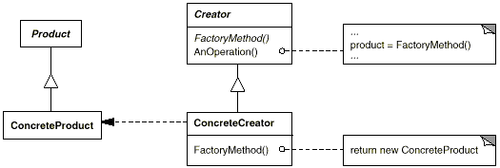
Factory Method
Structure

Slide 20
Factory Method
Participants
  Product (Document)
    defines the interface of objects the factory method creates.
  ConcreteProduct (MyDocument)
    implements the Product interface.
  Creator (Application)
    declares the factory method, which returns an object of type Product. Creator may also define a default implementation of the factory method that returns a default ConcreteProduct object.
    may call the factory method to create a Product object.
  ConcreteCreator (MyApplication)
    overrides the factory method to return an instance of a ConcreteProduct.

Slide 21
Factory Method
Collaborations
  Creator relies on its subclasses to define the factory method so that it returns an instance of the appropriate ConcreteProduct.

Slide 22
Factory Method
Consequences
  Factory methods eliminate the need to bind application-specific classes into your code. The code only deals with the Product interface; therefore it can work with any user-defined ConcreteProduct classes.
  A potential disadvantage of factory methods is that clients might have to subclass the Creator class just to create a particular ConcreteProduct object. Subclassing is fine when the client has to subclass the Creator class anyway, but otherwise the client now must deal with another point of evolution.

Slide 23
Factory Method
Related Patterns
  Abstract Factory
  Template Method
  Prototype

Slide 24
Structural Pattern:Composite
Intent
  Compose objects into tree structures to represent part-whole hierarchies. Composite lets clients treat individual objects and compositions of objects uniformly.

Slide 25
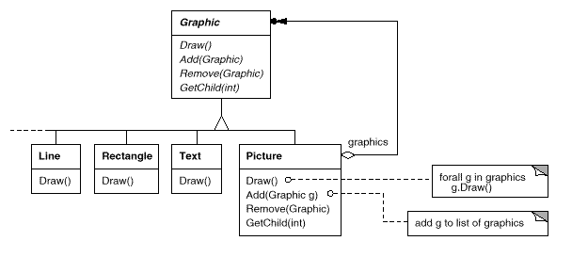
Composite
Motivation
  The key to the Composite pattern is an abstract class that represents both primitives and their containers

Slide 26
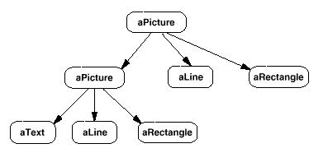
Composite
The following diagram shows a typical composite object structure of recursively composed Graphic objects:

Slide 27
Composite
Applicability
  Use the Composite pattern when
    you want to represent part-whole hierarchies of objects.
    you want clients to be able to ignore the difference between compositions of objects and individual objects. Clients will treat all objects in the composite structure uniformly.

Slide 28
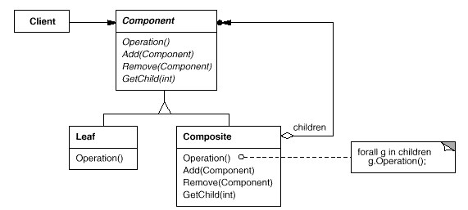
Composite
Structure

Slide 29
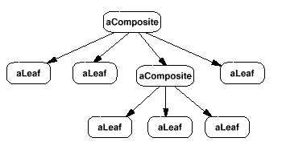
Composite
A typical Composite object structure might look like this:

Slide 30
Composite
Participants
  Component (Graphic)
    declares the interface for objects in the composition.
    implements default behavior for the interface common to all classes, as appropriate.
    declares an interface for accessing and managing its child components.
    (optional) defines an interface for accessing a component's parent in the recursive structure, and implements it if that's appropriate.
Leaf (Rectangle, Line, Text, etc.)
        represents leaf objects in the composition. A leaf has no children.
        defines behavior for primitive objects in the composition.

Slide 31
Composite (Picture)
  defines behavior for components having children.
  stores child components.
  implements child-related operations in the Component interface.
Client
  manipulates objects in the composition through the Component interface

Slide 32
Composite
Collaborations
  Clients use the Component class interface to interact with objects in the composite structure. If the recipient is a Leaf, then the request is handled directly. If the recipient is a Composite, then it usually forwards requests to its child components, possibly performing additional operations before and/or after forwarding.

Slide 33
Consequences
  The Composite pattern
    defines class hierarchies consisting of primitive objects and composite objects. Primitive objects can be composed into more complex objects, which in turn can be composed, and so on recursively. Wherever client code expects a primitive object, it can also take a composite object.
    makes the client simple. Clients can treat composite structures and individual objects uniformly. Clients normally don't know (and shouldn't care) whether they're dealing with a leaf or a composite component. This simplifies client code, because it avoids having to write tag-and-case-statement-style functions over the classes that define the composition.

Slide 34
Cont…
makes it easier to add new kinds of components. Newly defined Composite or Leaf subclasses work automatically with existing structures and client code. Clients don't have to be changed for new Component classes.
can make your design overly general. The disadvantage of making it easy to add new components is that it makes it harder to restrict the components of a composite. Sometimes you want a composite to have only certain components. With Composite, you can't rely on the type system to enforce those constraints for you. You'll have to use run-time checks instead.

Slide 35
Composite
Related Patterns
  Chain of Responsibility
  Decorator
  Flyweight
  Iterator
  Visitor

Slide 36
Structural Pattern:Facade
Intent
  Provide a unified interface to a set of interfaces in a subsystem. Facade defines a higher-level interface that makes the subsystem easier to use.

Slide 37
Facade
Motivation
  Structuring a system into subsystems helps reduce complexity. A common design goal is to minimize the communication and dependencies between subsystems. One way to achieve this goal is to introduce a facade object that provides a single, simplified interface to the more general facilities of a subsystem.

Slide 38
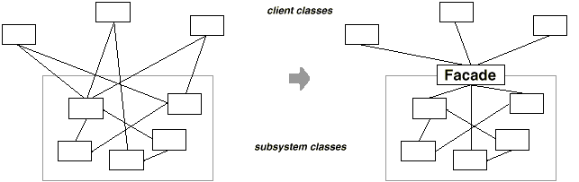
Facade

Slide 39
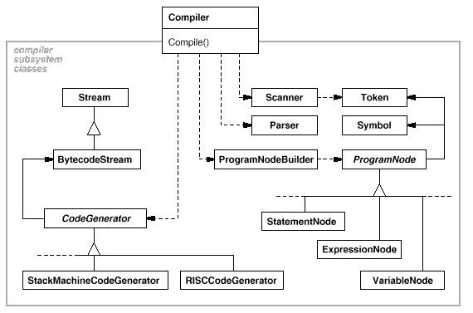
Facade

Slide 40
Facade
Applicability
  Use the Facade pattern when
    you want to provide a simple interface to a complex subsystem. Subsystems often get more complex as they evolve. Most patterns, when applied, result in more and smaller classes. This makes the subsystem more reusable and easier to customize, but it also becomes harder to use for clients that don't need to customize it. A facade can provide a simple default view of the subsystem that is good enough for most clients. Only clients needing more customizability will need to look beyond the facade.

Slide 41
    there are many dependencies between clients and the implementation classes of an abstraction. Introduce a facade to decouple the subsystem from clients and other subsystems, thereby promoting subsystem independence and portability.
    you want to layer your subsystems. Use a facade to define an entry point to each subsystem level. If subsystems are dependent, then you can simplify the dependencies between them by making them communicate with each other solely through their facades.

Slide 42
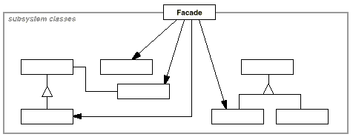
Facade
Structure

Slide 43
Facade
Participants
  Facade (Compiler)
    knows which subsystem classes are responsible for a request.
    delegates client requests to appropriate subsystem objects.
  subsystem classes (Scanner, Parser, ProgramNode, etc.)
    implement subsystem functionality.
    handle work assigned by the Facade object.
    have no knowledge of the facade; that is, they keep no references to it.

Slide 44
Facade
Collaborations
  Clients communicate with the subsystem by sending requests to Facade, which forwards them to the appropriate subsystem object(s). Although the subsystem objects perform the actual work, the facade may have to do work of its own to translate its interface to subsystem interfaces.
  Clients that use the facade don't have to access its subsystem objects directly

Slide 45
Facade
Consequences
  The Facade pattern offers the following benefits:
  It shields clients from subsystem components, thereby reducing the number of objects that clients deal with and making the subsystem easier to use.
  It doesn't prevent applications from using subsystem classes if they need to. Thus you can choose between ease of use and generality

Slide 46
Cont…
3. It promotes weak coupling between the subsystem and its clients. Often the components in a subsystem are strongly coupled. Weak coupling lets you vary the components of the subsystem without affecting its clients. Facades help layer a system and the dependencies between objects. They can eliminate complex or circular dependencies. This can be an important consequence when the client and the subsystem are implemented independently. Reducing compilation dependencies is vital in large software systems. You want to save time by minimizing recompilation when subsystem classes change. Reducing compilation dependencies with facades can limit the recompilation needed for a small change in an important subsystem. A facade can also simplify porting systems to other platforms, because it's less likely that building one subsystem requires building all others.

Slide 47
Facade
Related Patterns
  Abstract Factory
  Mediator

Slide 48
Creational Pattern:Singleton
Intent
  Ensure a class only has one instance, and provide a global point of access to it.

Slide 49
Singleton
Motivation
  It's important for some classes to have exactly one instance. Although there can be many printers in a system, there should be only one printer spooler. There should be only one file system and one window manager. A digital filter will have one A/D converter. An accounting system will be dedicated to serving one company.
  How do we ensure that a class has only one instance and that the instance is easily accessible? A global variable makes an object accessible, but it doesn't keep you from instantiating multiple objects.
  A better solution is to make the class itself responsible for keeping track of its sole instance. The class can ensure that no other instance can be created (by intercepting requests to create new objects), and it can provide a way to access the instance. This is the Singleton pattern

Slide 50
Singleton
Applicability
  Use the Singleton pattern when
  there must be exactly one instance of a class, and it must be accessible to clients from a well-known access point.
  when the sole instance should be extensible by subclassing, and clients should be able to use an extended instance without modifying their code

Slide 51
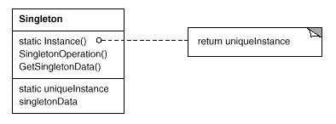
Singleton
Structure

Slide 52
Singleton
Participants
  Singleton
    defines an Instance operation that lets clients access its unique instance. Instance is a class operation (that is, a class method in Smalltalk and a static member function in C++).
    may be responsible for creating its own unique instance.

Slide 53
Singleton
Collaborations
  Clients access a Singleton instance solely through Singleton's Instance operation.

Slide 54
Consequences
  The Singleton pattern has several benefits:
  Controlled access to sole instance. Because the Singleton class encapsulates its sole instance, it can have strict control over how and when clients access it.
  Reduced name space. The Singleton pattern is an improvement over global variables. It avoids polluting the name space with global variables that store sole instances.
  Permits refinement of operations and representation. The Singleton class may be subclassed, and it's easy to configure an application with an instance of this extended class. You can configure the application with an instance of the class you need at run-time.

Slide 55
Cont…
  3. Permits a variable number of instances. The pattern makes it easy to change your mind and allow more than one instance of the Singleton class. Moreover, you can use the same approach to control the number of instances that the application uses. Only the operation that grants access to the Singleton instance needs to change.
  4. More flexible than class operations. Another way to package a singleton's functionality is to use class operations (that is, static member functions in C++ or class methods in Smalltalk). But both of these language techniques make it hard to change a design to allow more than one instance of a class. Moreover, static member functions in C++ are never virtual, so subclasses can't override them polymorphically.

Slide 56
Singleton
Related Patterns
  Abstract Factory
  Builder
  Prototype

Slide 57
References
Applying UML and Patterns by Craig Larman
  Chapter 23
GOF Notes on TEACHER NOTES

